Slide 1

Identifying Potential Quasars Using RATIR Data
Author: Kathleen Novoa-Perry
Mentor: Nathaniel Butler, PhD
Arizona Space Grant Symposium
April 16, 2016

Slide 2
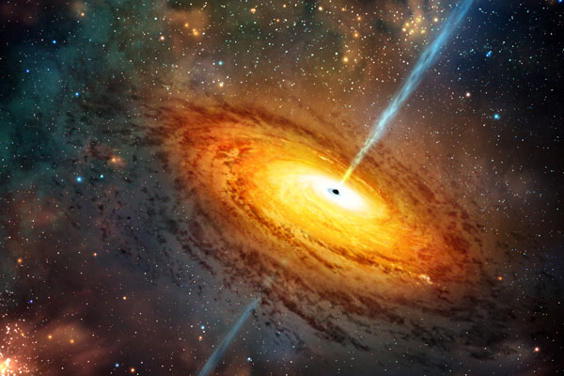
Objective
Image on the left: artist’s rendition of a galactic quasar
Dr. Butler conducted 206 observations between 2012 to 2014. Using this data and a qso-fit code written by Dr. Butler in Python, I was able to calculate the variability metrics for the qso (quasar) and non-qso sources.
After calculating these values, I was tasked with identifying potential quasar sources upon plotting the metrics against one another.

Slide 3
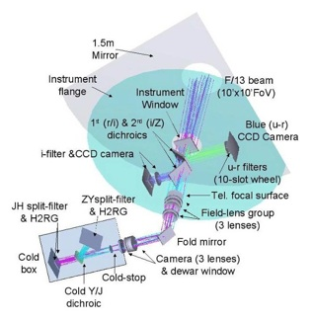
Instrumentation
The RATIR (Reionization and Transients Infrared camera) is mounted on the 1.5m Johnson telescope in Baja California, Mexico
It consists of two arms: one optical and one infrared. The optical arm images in the red and infrared while the infrared arm images in four NIR bands: Z, Y, J, and H
RATIR is 100% dedicated to the detection of high redshift GRBs
Finally, I used Python to calculate all of the necessary metrics and to create to required qso vs non-qso plots
Above image: RATIR camera diagram

Slide 4
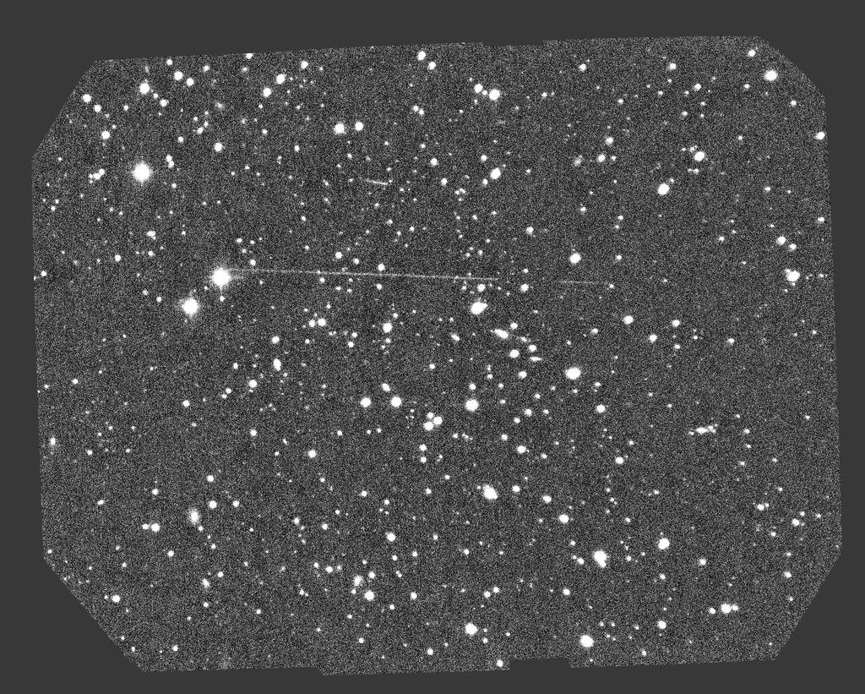
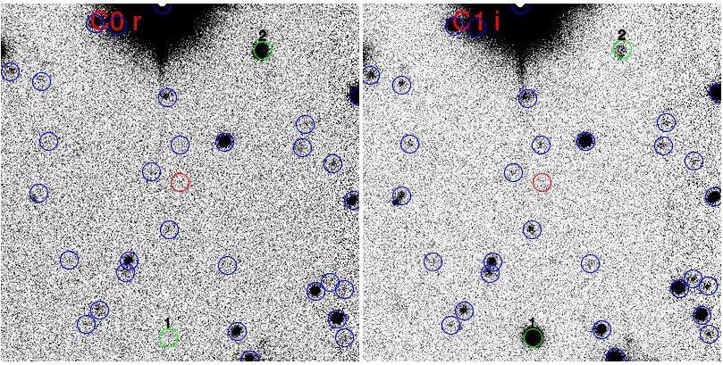
Data
To the left, are raw sample images of some of the over 1200 images taken
There were 27 target quasars imaged from Nov. 2012 to June 2014
Using catalogues such as USNO, 2MASS, and SDSS, we were able to properly identify a good number of the light sources in each of our images
These images are given as they show a decent amount of point sources of light as well as a good example of different sources peaking in different wavelengths.
This can be seen clearly in the four green circles.
Above Image: RATIR ZY Band Image 20130815/2013B-1006/1326030033
Image A: Source unknown/added to show magnitude difference of different filters

Slide 5
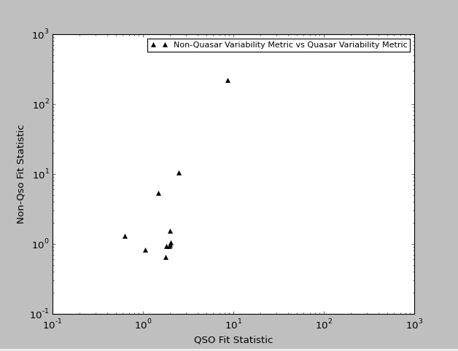
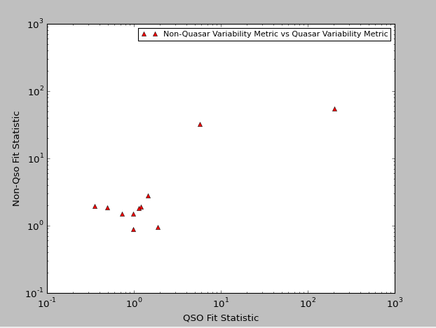
Variability Metric Example Plots
Image D, above, shows one of the six plots (one for each operating band) that were created using Python
Each point is the combination of the variability metrics representing one of our potential quasars
While most are clustered around the same area of the plot, we do have a few stragglers
These stragglers are of particular interest as they could signal quasar light sources
In these kinds of plots, quasars are categorized as being toward the upper end of the y-axis while the larger cluster were usually determined to be stars (Butler-2011)
Quasars that were identified tended toward low variability at high redshifts and they were distributed on the lower end of the x-axis while higher variability sources tended toward the higher end of the x-axis (Butler-2011)
While the research is still being conducted, I do have a somewhat clear idea of potential quasar sources in this plot such as top three highest points

Slide 6

Special Thanks
A sincere thank you to Dr. Butler for all of his help and guidance during this internship
Finally, thank you to everyone at ASU/NASA Space Grant for providing me with an incredible opportunity to work on an exciting research project with a great mentor!

Slide 7
Questions?

